Slide 1

Phishing Awareness Training
Think Twice, Click Wise​

Slide 2

WHAT IS PHISHING?
Phishing is the most common form of social engineering for stealing an individual’s personal information like IDs or passwords, or for installing malware which can be used for various purposes including ransomware attacks.
This is typically done through fraudulent emails, text messages, or websites designed to appear legitimate. Phishing attacks often use social engineering tactics to trick users into taking actions that compromise their security or privacy.

Slide 3

94%
Of malware on computers found their way there via phishing email.
67,5%
Of individuals that click on a phishing link are likely to enter their
credentials on a phishing website.
2 Million+
Phishing sites have been found and registered as malicious by
Google as of January 2021.

Slide 4


How Does Phishing Work?
Phishing emails often appear to be from legitimate sources like banks, social media platforms, or even friends and family.
Phishers frequently use tactics like fear, curiosity, a sense of urgency, and greed to compel recipients to open attachments or click on links.
The emails contain malicious links or attachments that, when clicked, can steal your information or infect your device with malware.

Slide 5



Phishing Techniques
01. Malicious Web Links
02 . Malicious Attachments
03. Fraudulent Data Entry
Forms

Slide 6
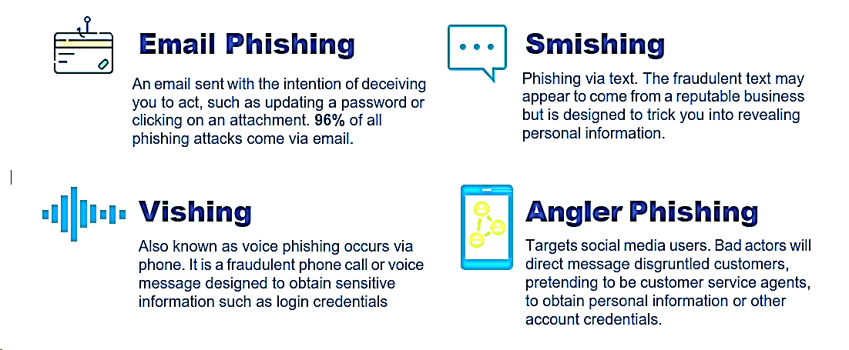
Different Types of Phishing Attacks

Slide 7
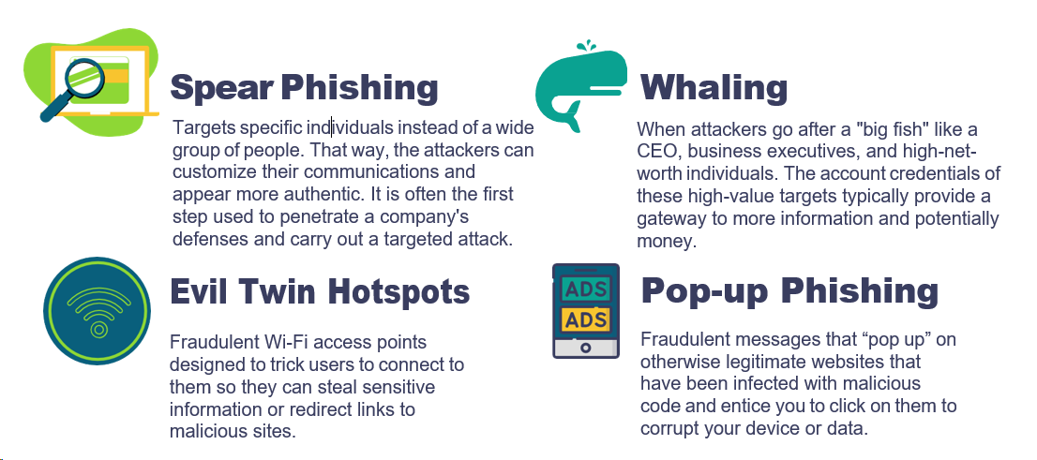
Different Types of Phishing Attacks

Slide 8

Phishing tips to protect you
Avoid unknown senders. Check names and email
addresses before responding.
Don’t trust links or attachments in unsolicited EMAILS.
Be suspicious of emails marked “urgent”.
Beware of messages with mistakes in spelling or
grammar.

Slide 9
Phishing tips to protect you
.
When receiving email from known institutions (government, banks, your doctor),go directly to the source instead of clicking on links in the email.
Never give out personal or financial information based on an email request.
Be wary of generic greetings, such as dear sir or ma’am.
Don't be lured by “deals”. They are usually too good to be true.

Slide 10


ROHITH KUMAR R
CODE ALPHA REMOTE INTernship
Rkr411 (Rohith Kumar R) (github.com)

